Slide 1
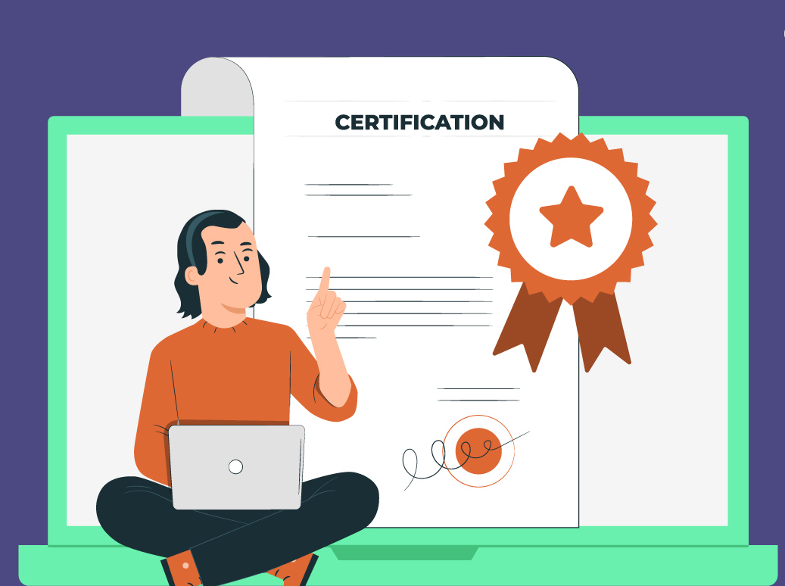
DATA ANALYTICS PROCESS Finding Best Online Certification Course
By Shahnawaz Akhtar
1

Slide 2
AGENDA
Objective
Background
Data Analytics Steps:
Plan
Prepare
Process
Analyse
Share
Act
Conclusion

Slide 3

Objective
Searching the best online certification Course using data analytics and explaining it with six steps data analytics process i.e. plan, prepare, process, analyze, share and act.

Slide 4
Proceeding with data analytics process
1. Plan-
Objective: Identify the top online certification Course by examining factors like cost, duration, content quality, industry reputation, and user reviews.
Stakeholders: Individuals looking for certifications, educational institutions, employers, and career advisors.
Key Questions:
Which Courses are the most cost-effective?
Which Courses have the best user satisfaction ratings?
What are the lengths and comprehensiveness of these Courses?
How well-recognized are these certifications in the industry?

Slide 5
2. Prepare
Data Collection:
Sources: Online education platforms like Coursera, Udemy, edX, LinkedIn Learning.
Data Types: Course costs, user reviews and ratings, Course durations, curriculum details, and industry recognition.
Data Gathering Methods:
Extract data from websites, reviews, and industry reports.
Use APIs or web scraping tools to collect information systematically.

Slide 6
3. Process
Data Cleaning and Preparation:
Remove any duplicate or irrelevant data.
Handle missing values (e.g., fill in missing ratings or durations).
Standardize data formats (e.g., ensure all costs are in the same currency).
Data Transformation:
Convert categorical data (e.g., Course types) into numerical formats if needed.
Normalize numerical data for comparison.

Slide 7


4. Analyze
Exploratory Data Analysis (EDA):
Use statistical methods to identify patterns and trends.
Visualize data with charts and graphs to understand distributions and relationships.
Modeling:
Apply ranking algorithms to compare Courses based on multiple criteria.
Use clustering to group similar Courses together.
features | Google Data Analytics Professional Certificate | IBM Data Science Professional Certificate | Coursera Data Science Specialization
Duration | 6 months | 6 months | 9 months
Cost | ₹1000/month | ₹1500/month | ₹2500/month
Career prospects | good | good | good
Real life projects | yes | yes | yes
Instructor | Google Employees and Industry Experts | IBM Employees and Industry Experts | Coursera Faculty and Industry Experts
Reviews | 4.8/5 | 4.6/5 | 4.4/5
From above analysis I found Google Data Analytics Professional Certificate is the best fit for me.
7

Slide 8
5. Share
Communication of Results:
Create visual dashboards to present the findings.
Prepare reports summarizing the top certification Courses.
Highlight key insights and recommendations for different stakeholder groups.
Presentation:
Use visual aids like bar charts, pie charts, and scatter plots to make the data easily understandable.
Provide clear and concise summaries of the findings.

Slide 9
6. Act
Implementation:
Advise prospective students on the best certification Courses based on their needs and goals.
Collaborate with educational institutions to improve their offerings based on feedback and analysis.
Monitor the outcomes and continuously gather feedback to refine the recommendations.

Slide 10
Conclusion
The six-step data analytics process—Plan, Prepare, Process, Analyze, Share, and Act—we can systematically identify the best online certification Courses. This approach ensures that decisions are data-driven and tailored to the needs of various stakeholders.
Plan: Defined objectives, key questions, and identified stakeholders.
Prepare: Collected comprehensive data from reliable sources.
Process: Cleaned and transformed data for accuracy and consistency.
Analyze: Uncovered insights and trends through exploratory analysis.
Share: Communicated findings via visual dashboards and reports.
Act: Implemented insights, advised students, and refined recommendations.
I have decided to upskill myself by doing an online certification course in data analytics
I wanted a 3-6 months duration budget friendly course with real life projects
I found Google Data Analytics Professional Certificate is the best fit for me

Slide 11


